Slide 1
EU Copyright Directive
EU Copyright directive on its way!

Slide 2
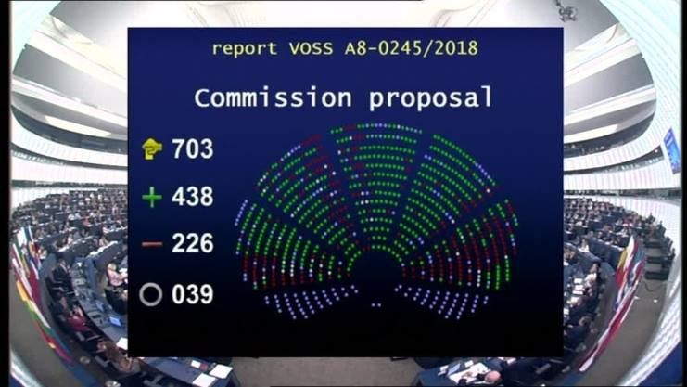
The Vote of European parliament of 12 September allows the EU copyright directive to go into “trilogue” .
Notes:
On 12 September the European Parliament voted overwhelmingly the amended version of the Copyright Directive that was originally rejected on 5 July by 30 votes.
The most controversial passages of the law – art. 11 and art.13 - have been watered down.

Slide 3
„Trilogue“ last step of EU legislative process
European Commission
Proposes Draft Legislation
Can Withdraw Draft
Council
Initiates Legilastion
Amends Proposal by EU Commission
European Parliament
Amends Proposal by EU Commission (committees)
Votes on final version (Plenary)
Notes:
The voted version can now go into “trilogue” between the three EU institutions to agree on a final text.
The legislation will face a final vote in European Parliament early 2019.
Probability of a positive vote: High (based on analysis of the votes of 12 September)
But expect fierce anti-copyright campaign against the text in the hope of swinging the vote of undecided MEPs

Slide 4
implementation
2019
Vote in Plenary of European Parliament
Publication in the official journal of the EU
Entry into force 20 days later
2020
Period of implementation: one year (Art.21)
2025
Implementation review after five years (Art.22)
What is with BREXIT?
Notes:
Notes: 2020 is after Brexit
Brexit enters into force in March 2019.
The transition period ends on 31st December 2020, so if the directive is agreed and confirmed in 2019, it is possible to implement it before that time. The sentiment in the UK on copyright is for reciprocity. So if the UK leaves the EU there remains a possibility of implementing the directive afterwards.

Slide 5
Two controversial articles to leverage the relationships between stakeholders online
Art. 11
Art.13
(and recital 38)
Art.13 b) NEW
Establishes a new neighbouring right for press publishers on their digital publications
20 years, waivable
Liability of online platforms for infringing content under certain circumstances
Incitation to license - but no obligation to license. Obligation to negotiate „in good faith“
„Automatic blocking of content“ should be avoided
(text voted by EP)
Image Search Engines are specifically required to „conclude fair and balanced licensing agreements“ with „any requesting right holders“ in order to ensure their „fair remuneration“.
Notes:
Will any of these rights in the directive be waivable? No
How will this impact the stock licensing industry?
Article 13b (new) Member States shall ensure that information society service providers that automatically reproduce or refer to significant amounts of copyright-protected visual works and make them available to the public for the purpose of indexing and referencing conclude fair and balanced licensing agreements with any requesting rightholders in order to ensure their fair remuneration. Such remuneration may be managed by the collective management organisation of the rightholders concerned. It is not sure this article will survive the trilogue!

Slide 6




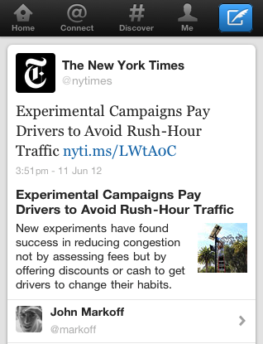
Art 11. In practice
Google News “snippets”
Public Relations Consultants Association v The Newspaper Licensing Agency Ltd
([2013] UKSC 18
Relevant for photo-journalists or news picture agencies !
Notes:
“The neighbouring right gives publishers a better chance of negotiating more favourable terms and conditions with dominant platforms that use publishers content. ” (Angela Mills-Wade, executive director of the European Publishers Council)
Public Relations Consultants Association v The Newspaper Licensing Agency Ltd ([2013] UKSC 18, on appeal from: [2011] EWCA Civ 890 ) was a 2011 case UK Supreme Court case decided in 2013.you can’t judge on the basis of the items individually. It is the cumulative effect. Eg the uk meltwater case went all the way to the high court which ruled that the size or originality of the headline or snippet was irrelevant as the sheer scale of the scraping and reproduction and making available required a licence. But meltwater were selling a service.

Slide 7
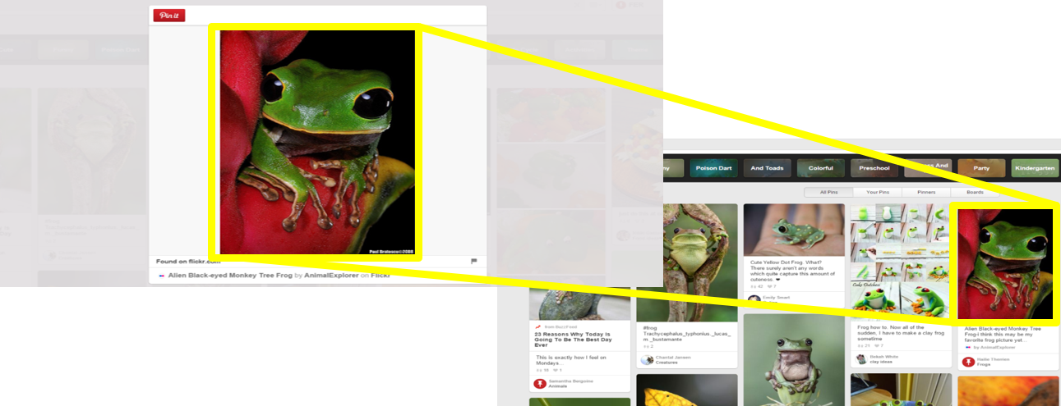
Art. 13 In practice
Frog photo of Getty Images on Pinterest
Notes:
Will customers be able to license images for advertisements that might be uploaded to social media platforms? Sure. These photos are not at stake: they are covered by a license already allowing the online publication! The photos at stake are photos “uploaded by third parties” : for example this frog is a picture of Getty Images. A user X uploaded the picture on Pinterest.

Slide 8
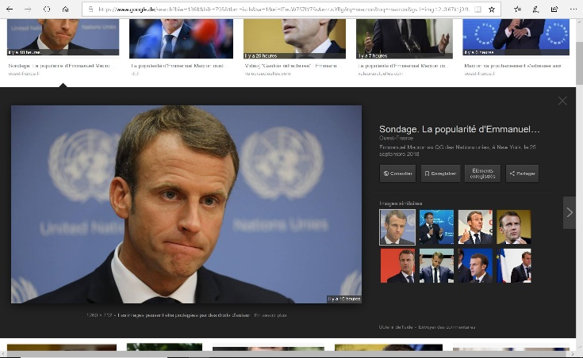

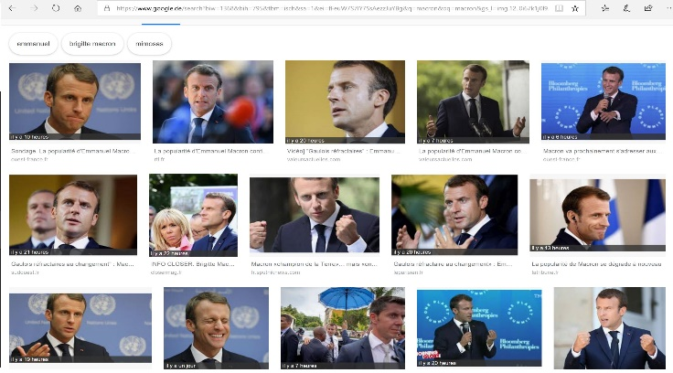
Art. 13 b) In practice
Image Search engines are required to conclude fair licenses with “any requesting rightholder”
“May be managed by CMOs”
Based on French law on image search engines (2016) Has not entered into force!
Are framed images covered?
Notes:
Image Search engines are required to conclude fair licences with “any requesting rightholder”
Because “Framing” is not covered by the Directive or/and excluded of copyright protection by CJEU, only first page is “licensable”
Second page with high res. Pictures remains out of the scope of the directive.
Amendment adopted by European Parliament on a proposision of French MEP Cavada. Chances to go through 50/50
Will collecting societies be involved? Yes. But that is not necessarily a bad thing. Large players like Getty Images or Shutterstock will be able to conclude licenses on their own. Smaller agencies will be happy to work yith collecting societies like for other usages at the moment.

Slide 9
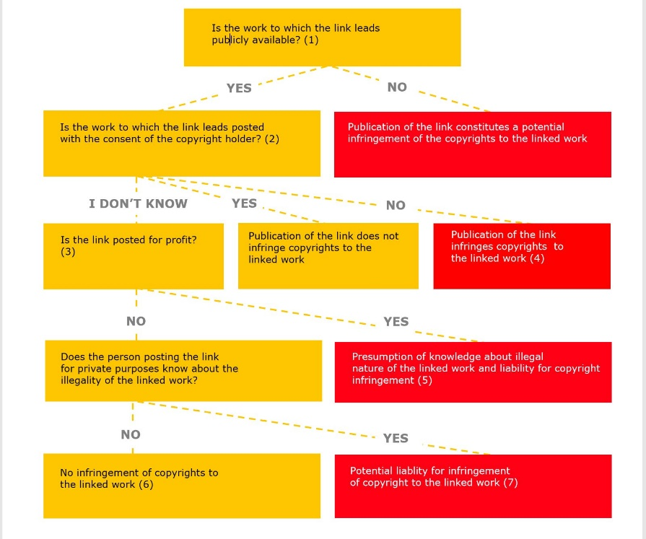
Framing?
Svensson 2014 (new public)
Bestwater 2014 (framing of content freely available on the internet)
GS Media 2016 (element of subjectivity)
Renckhoff 2018 (confirmation of precedent jurisprudence)
Art. 11 “This protection does not extend to acts of hyperlinking.” (Recital 34)”

Slide 10
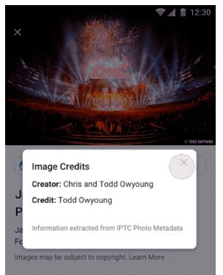
Art. 13 In practice: the use of technology
Licensing agreements
“Automatic blocking of content” to be avoided
Negotiations “in good faith”
“CEPIC looks forward to working with Google on further improvements in order to promote and protect images online and reduce image piracy.”
Without legal pressure, by law or by court, it’s nearly impossible to reach agreement with a dominant or/and monopolistic player
Notes:
Art. 13. The recent agreement of CEPIC with Google on the display of the IPTC fields can be considered as an application of Art.13. The legal pressure around Google practices in the EU has created an incentive for Google to enter into negotiacions (“talks” “dialogue” “collaboration”)

Slide 11
Q&A
Notes:
Q&A - Time permitting
Closing: We’re almost out of time and as you can tell there’s still a lot to discuss. Any final words from our panelists?
Lunch is now available and the panelists will be at lunch - feel free to join them at the round table discussions. Before we go, I’d like to thank our panelists for their time today. Please enjoy the rest of the conference.

Slide 12

THANK YOU!
Sylvie Fodor (s.fodor@cepic.org), CEPIC, Nordic Conference 15 November 2018

